Slide 1
Roundabout In A Cornfield
Illinois 47 at Burlington Road,
One Year Later
February 2018

Slide 2
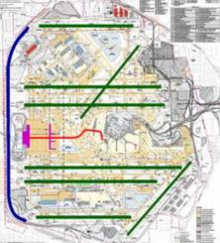

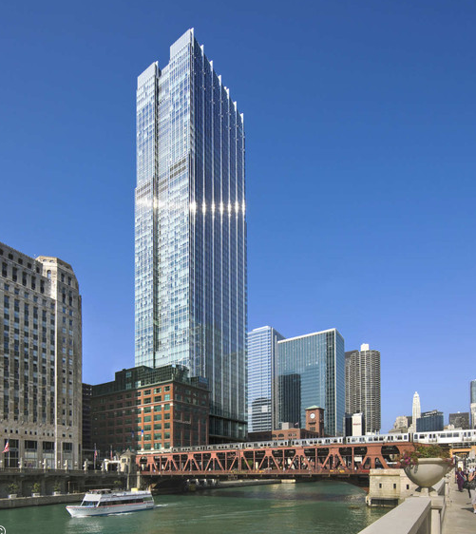
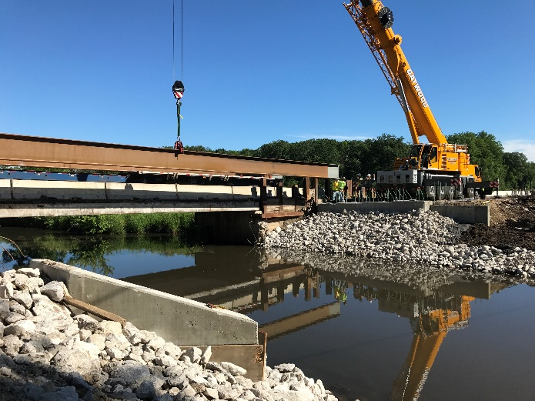
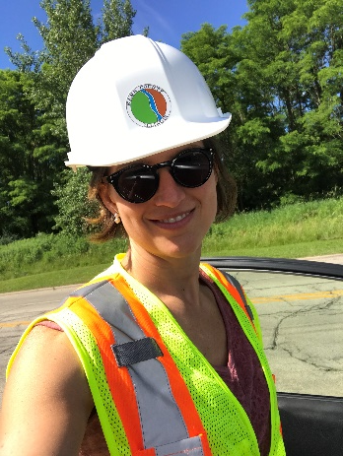
Your Presenters
Jennifer O’Connell, Kane County DOT
Notes:
JEN
I am Jennifer O’Connell, I attended school here at the U of I, and for the decade after that I got a lot of experience in civil site design, including some high rises downtown. During the great recession I was lucky enough to do runway design with the O’Hare Modernization Program. After that I made a conscious decision to move to roadway design. 4 years ago my family left Chicago for the suburbs and I began working as a senior project manager for the Kane County Division of Transportation.

Slide 3
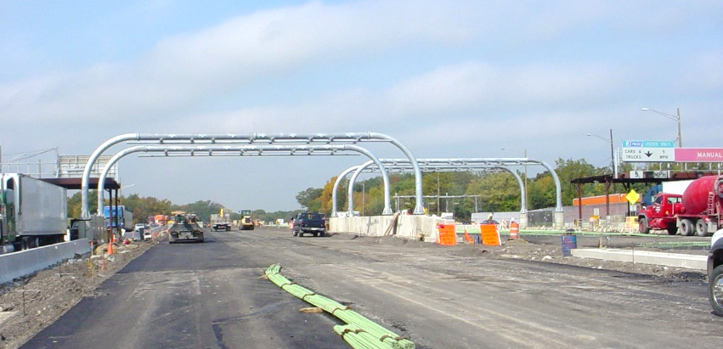
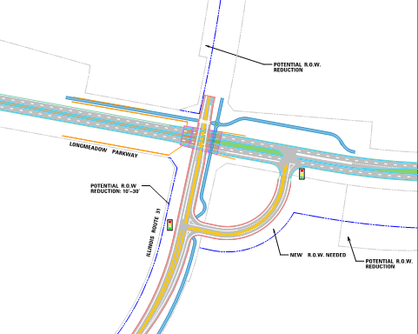
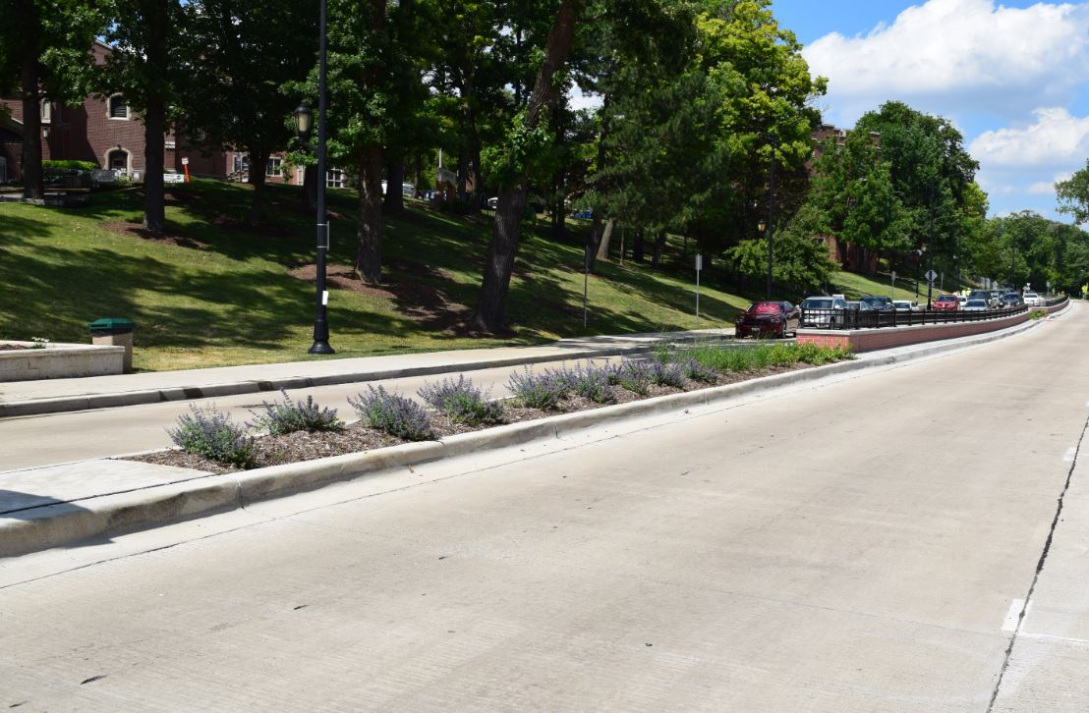

Your Presenters
Matt Papirnik, Burns & McDonnell
Notes:
MAP
I am a transportation engineer who has been practicing highway design for twenty years, with a brief exception. Some of my favorite projects over the years have been the implementation of ORT, the reconstruction of Crescent Boulevard in Glen Ellyn, and the concept verification and phase ii design of Longmeadow Parkway in Kane County.

Slide 4
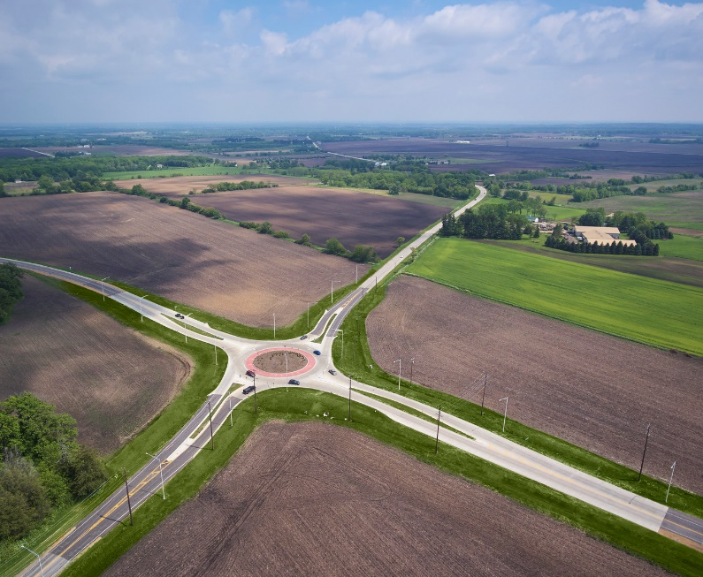
Overview and Purpose
NOT a “Lessons Learned”
Rather, we’d like to examine
the decision-making process
The analysis & design process is a useful template for those who are new to the implementation of roundabouts.
Notes:
JEN 3:
Rather than point out our many shortcomings and a do a “lessons learned”
type presentation, Matt and I decided to walk you through the
Decision making process that took us from traffic signal to roundabout at this
project location.
Simply because our lesson learned might not apply to you. But the thought process
and logic we employed would and that is what we are here to focus on today.
The analysis and design process for the Burlington 47 roundabout is a
useful template for those agencies and communities who are new
to the implementation of roundabouts.
Because there are still over 90 counties in Illinois whose next roundabout will be
their first and the steps you must take to implement the first one can be daunting.
We hope that our experience can prove useful. Because it is really is a decision
making process and employing this process may lead you in a direction you don’t expect.
So no matter where you fall on the spectrum of support for the modern roundabout
hopefully what we discuss here today will help you understand at least our decision to build this one

Slide 5
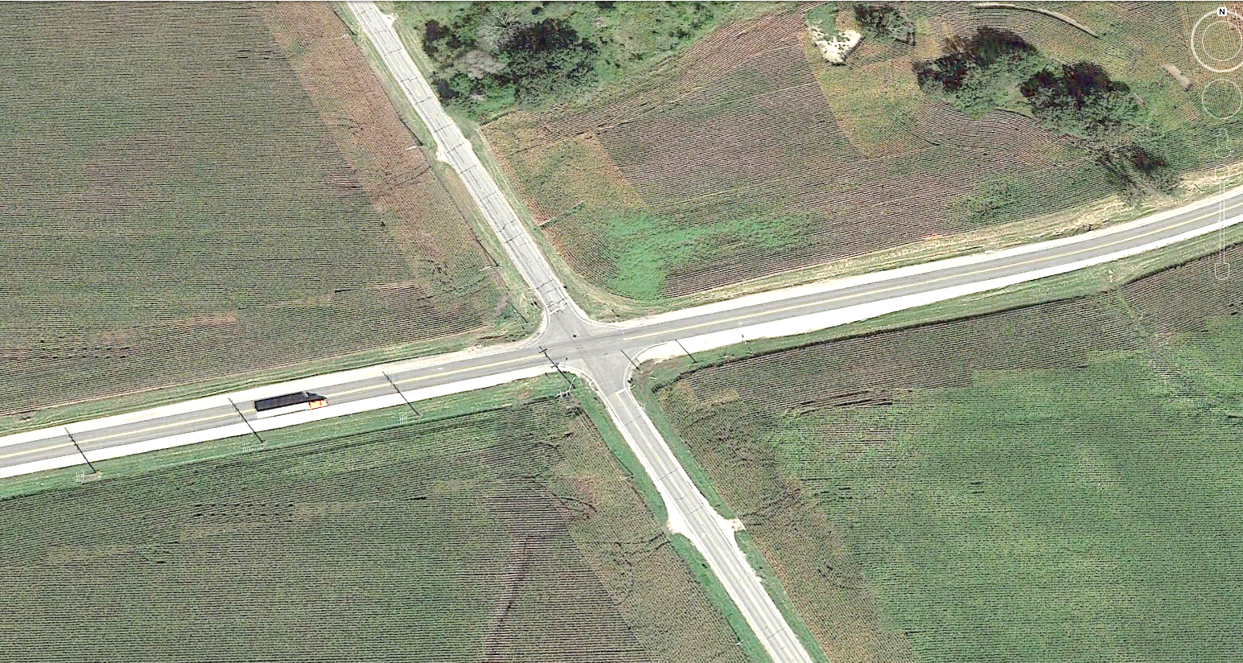
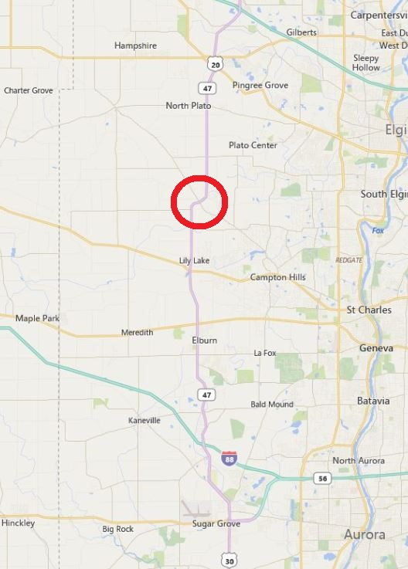
Key Decisions
Project Location
Illinois Route 47
Burlington Road
Notes:
MAP1
Ironically, the really big decision here – the one to build a roundabout – was actually made FOR us nearly as much as it was made BY us.
Existing intersection: two-lane roads on all four legs. Very flat, very straight, good sight distance. Existing control was a four-way stop; it had been a two-way stop until a series of severe and fatal crashes in the 1990s. Intersection location on the perimeter of Kane County suburban development meant that traffic growth was exceeding the capacity of the stop sign control.
The answers to our questions sometimes have little relation to the questions we ask. That was the case with this roundabout… and the question here was “What traffic signal design can we implement at this intersection with the money we have?” Before this project, it took multiple special meetings to even consider building one on an IDOT route; now, it is pretty much State policy that a RAB be at least considered in every intersection design the Department undertakes.

Slide 6
Concept Selection
Priorities
  Cost
  Safety
  Operations
Notes:
MAP2
The purposes of the project were 1) to provide a modestly-priced improvement, preferably using SRA criteria; 2) to maintain the excellent safety record of the existing intersection; 3) to provide a significant improvement in capacity over the existing four-way stop.

Slide 7


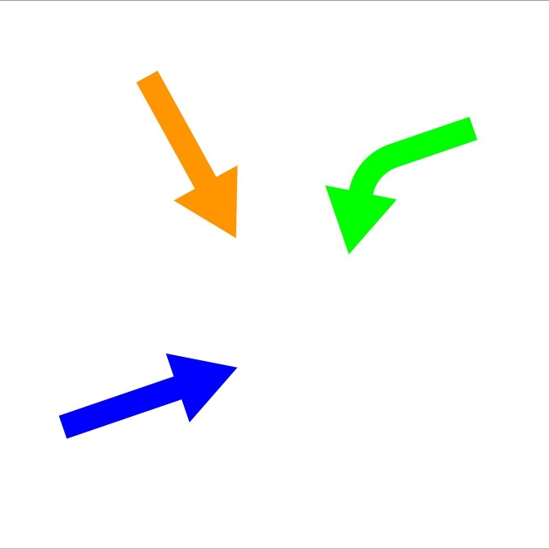
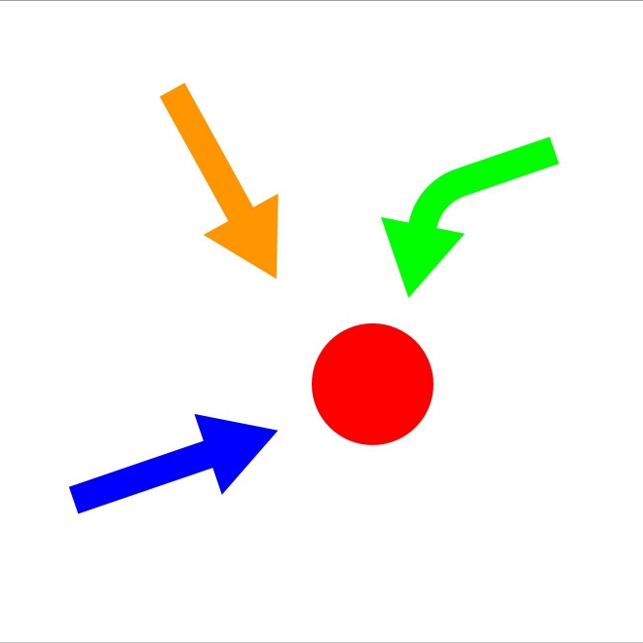
Concept Selection
Complications
  Safety concerns
  SRA criteria
  Unusual Traffic Patterns
  Topographic complications
  The cost of a signal doubled over initial scope.
Next Steps:
  “Find a way to save money.”
Notes:
MAP2
The traffic signal concept suffered from a number of disadvantages –
SAFETY: The one good thing about the four-way stop is that it was safe, with 9 crashes in 5 years. Before that, it was a two-way stop – and the safety record of the two-way stop is WHY it became a four-way stop. A traffic signal threatened to restore some of the conditions (particularly high speed on the approaches) which made the signal unsafe in the first place.
OPERATIONS: The traffic signal was challenged by the fact that three competing movements (NE-bound left, SW bound through, SE bound through) were comparably large in the peak period. With only one of these allowed to go at a time, the signal didn’t operate very well. It was also necessary to provide auxiliary lanes for every turning movement – even though several of them counted in the single digits. Design volumes were not quite large enough for multiple through lanes – which would have tremendously exceeded the project budget – but the single lanes required relatively large shares of green time in the IDS. Two movements actually recorded an LOS of D – a design exception (albeit one we’d worry far less about today than during the design effort).
COST – The design expanded as new issues were identified and addressed, until the final cost doubled to over $3 million.
ENVIRONMENTAL IMPACT: Large areas of little-used pavement were necessary to provide the turn lanes, shoulders and intersection area. The ground is so flat that ditches large enough to handle the runoff were not sloped enough to convey runoff.
By the time the final geometry had been approved, the cost of the project had nearly doubled over initial estimates – well beyond what was covered by the CMAQ grant.
It took us eighteen months to realize that we weren’t thinking big enough – that a traffic signal wasn’t the right solution here. That waste of time and energy was perhaps the biggest failing we encountered on this project.

Slide 8
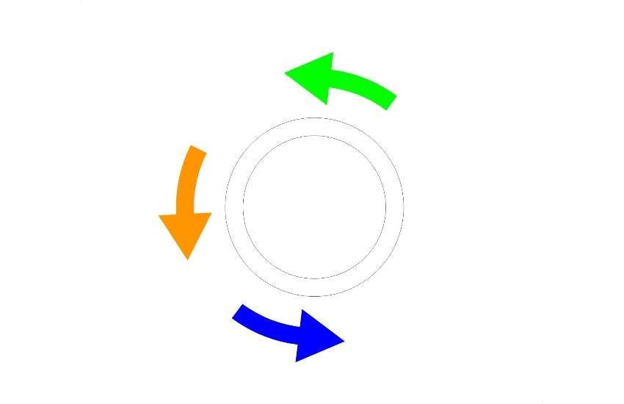
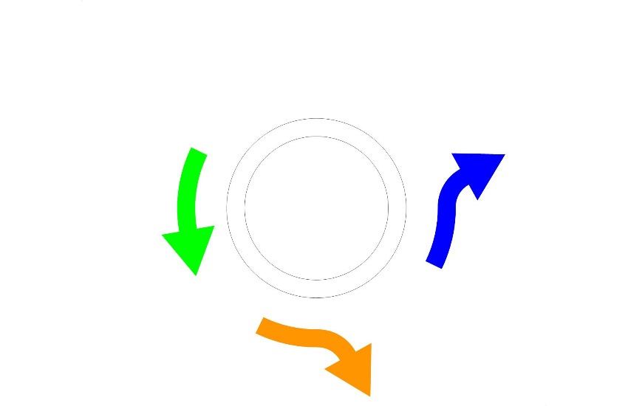
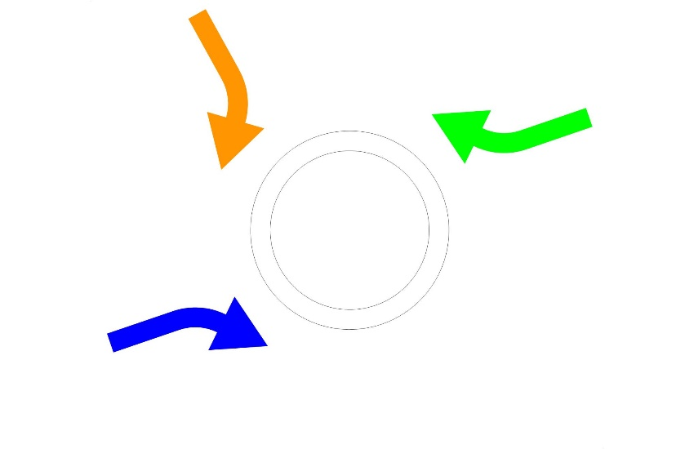
Preliminary Engineering
Early Design
  Roll out concept to Kane DOT, IDOT
  Become more informed
“Selling” the roundabout
  Preponderance of evidence…not enough.
  However, every technical
  factor favored a roundabout…
  SAFETY
  OPERATIONS
  COST
  ENVIRONMENTAL IMPACT
IDOT / FHWA approves new concept
…but need to address Year 2030 projections…
Notes:
MAP3
At the time I recommended the use of a roundabout, I had no real idea how to design one. My initial attempts were pretty weak. But I kept working on it, and as I learned more about roundabout geometry I also learned more about the benefits of a RAB. And I was surprised by what I found.
SAFETY: By comparison to the traffic signal issues, the RAB basically took the four-way stop and… kind of converted it into a four-way ROLLING stop. So driver expectations and behavior was similar, but the design was more efficient.
OPERATIONS: Remember the key competing movements which hampered the traffic signal? A roundabout can handle them simultaneously. As we modeled the roundabout, we found that the approaches to the intersection – which required three lanes for the traffic signal design – could be handled with a single traffic lane as a roundabout.
COST – The effective design speed of the roundabout – 25 mph – meant that long approaches were no longer needed. With long three-lane approaches replaced by shorter, single-lane approaches, the cost of the improvement was reduced by a million dollars, to 1.95 million.
ENVIRONMENTAL IMPACT: Less pavement, less cost – less impact to the environment. There was even the opportunity to replace intersection pavement with an environmentally-friendly landscaped circle island.
…. The only issue was the fear of the unknown.
The decisions made by the County on the Burlington/47 roundabout were made based on research, peer review and coordination rather than experience. This made the entire process, from conception to completion, something of a leap of faith. We believe that the lessons we learned from our roundabout may not be the least bit applicable to yours – but the preparation, consideration, research and engineering will be highly relevant.
Having seen the RAB in operation for a year now, we can say that the most important factors in our success were: our consideration of a range of outcomes, rather than a fixed value (e.g. “2030 Projections”), and our knowledge of what the key issues were in each phase of implementation. We advise other counties looking at this kind of work to own it and to understand it thoroughly. An outsider solution will disappoint you and the people you represent.
A key issue in defining the scope of our roundabout was the issue of traffic projections. The issue of backups at the four-way stop was incontrovertible – they were happening in both peak periods in front of me. I personally timed the delay using a stopwatch. The more difficult issue was future growth. During Phase II design, this area of Kane County was developing very rapidly, and traffic volumes were expected to double by 2030.

Slide 9
Preliminary Engineering
Year 2030 Projections
Leg | 2010 Actuals | Year 2030 Projections (2010) | Projected Growth
North (IL 47) | 8,200 | 16,000 | +95%
South (IL 47) | 7,800 | 16,000 | +105%
East (Burlington) | 4,000 | 9,000 | +125%
West (Burlington) | 3,500 | 8,000 | +129%
Notes:
MAP4
Huge growth was forecast.
It’s important to understand why this kind of growth was such a concern for the roundabout…

Slide 10
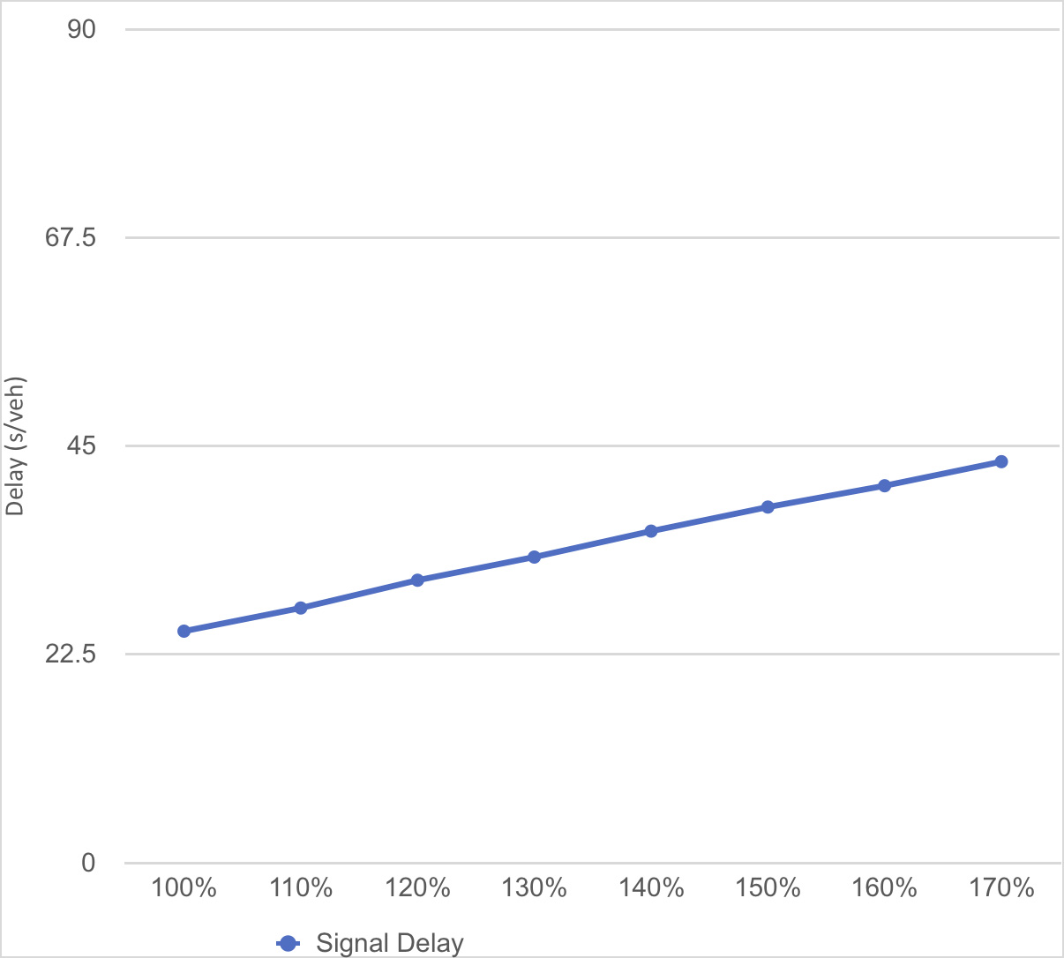
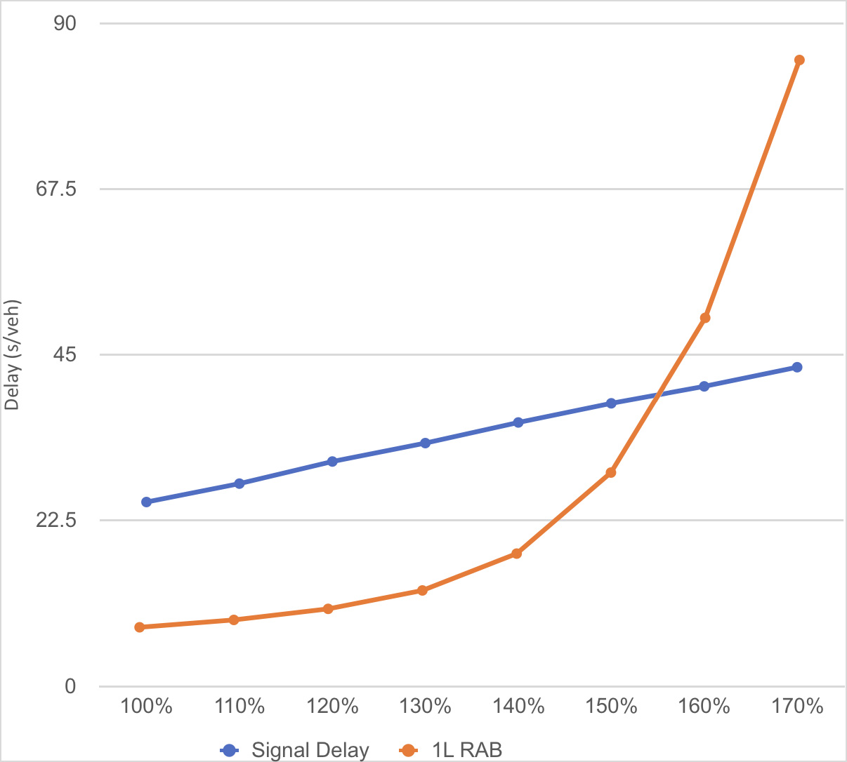
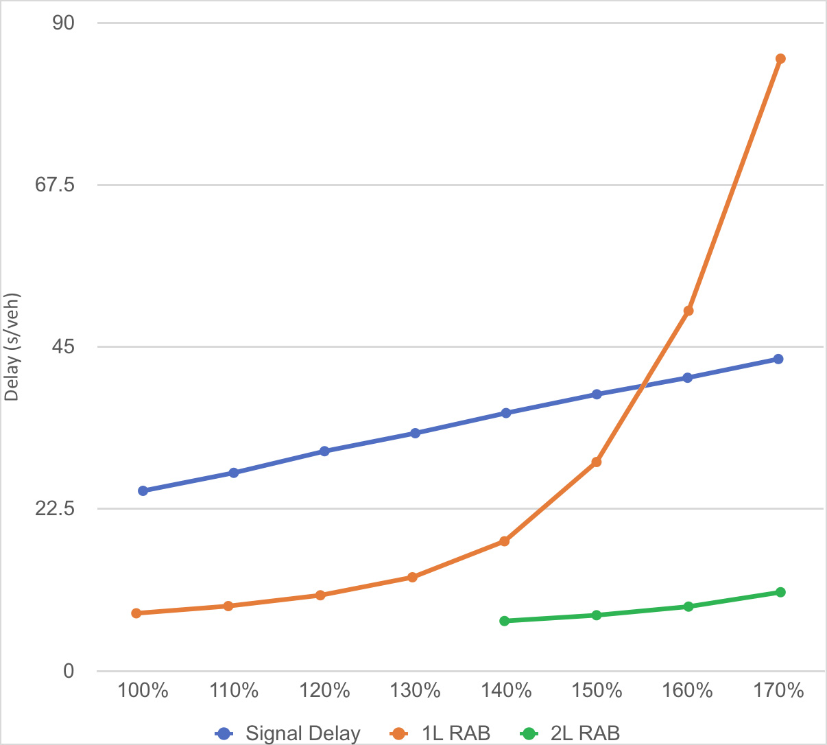
Preliminary Engineering
Roundabout delay vs. traffic signal delay:
Notes:
Delay increases linearly with a signal.
It increases exponentially with a RAB as the RAB approaches capacity – which ours was predicted to do.
So we modeled it with a second entry lane on IL 47, and it worked. (Add lanes on RABs are much shorter than those on high-speed signalized intersections, so the cost proposition of a second lane wasn’t nearly as critical with the RAB.)

Slide 11
Preliminary Engineering
Was the single-lane design the right way to go?
Was expandability a proper approach?
Leg | 2010 Actuals | Year 2030 Projections (2010) | Year 2017 (interpolated from Year 2030 projections) | 2017 Actuals
North (IL 47) | 8,200 | 16,000 | 10,930 | 8,344
 |  | +95% | +33% | 2%
South (IL 47) | 7,800 | 16,000 | 10,670 | 7,525
 |  | +105% | +37% | -4%
East (Burlington) | 4,000 | 9,000 | 5,200 | 4,439
 |  | +125% | +30% | 11%
West (Burlington) | 3,500 | 8,000 | 5,200 | 3,458
 |  | +129% | +49% | -1%
Leg | 2010 Actuals | Year 2030 Projections (2010) | Year 2017 (interpolated from Year 2030 projections)
North (IL 47) | 8,200 | 16,000 | 10,930
 |  | +95% | +33%
South (IL 47) | 7,800 | 16,000 | 10,670
 |  | +105% | +37%
East (Burlington) | 4,000 | 9,000 | 5,200
 |  | +125% | +30%
West (Burlington) | 3,500 | 8,000 | 5,200
 |  | +129% | +49%
Notes:
MAP4
[This needs no scripting, really. Go through the differences between where we thought we’d be in 2017 and where we actually are.]
Was expandability a proper approach? Interestingly enough, I stood in this exact spot and answered a question on that topic from Cathy Kibble. (“Are you here this afternoon?” “Phew.”/”Crud. Ok. I’d better get this right, then.”)

Slide 12
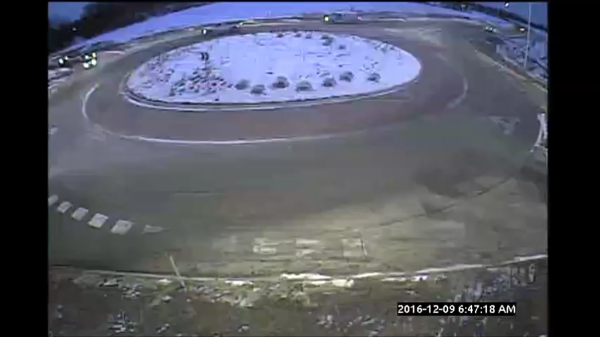
Traffic Operations
Notes:
It works!
Not only operationally and from a capacity standpoint… but it provides an economic benefit too.

Slide 13
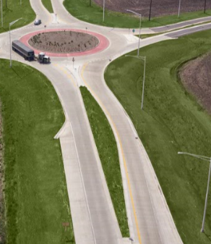
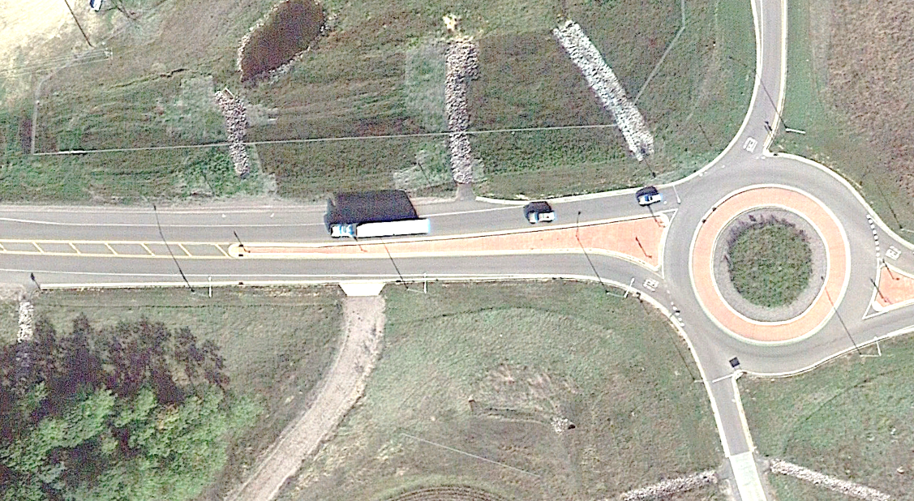
Preliminary Engineering
Design Details
  Three-curve deflection
  AutoTurn
  “It’s a very nice starter roundabout.”
Notes:
MAP6
Compare our design to one of the more current efforts in Wisconsin and talk about the way we were way more assertive on deflection.
Finally, there was the matter of AutoTurn and the size of apron. We were quite diligent in the use of Autoturn to develop the geometry we needed for the truck apron. According to our analysis, the truck apron was the appropriate size to serve the trailer of a WB-65 navigating the roundabout. As the video on the next slide will graphically illustrate, we were wrong.

Slide 14
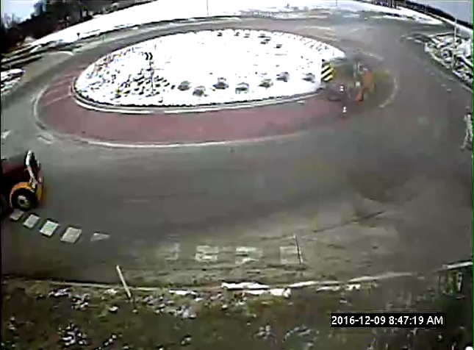
Truck Apron Design
Notes:
Turns out that around ¾ of the trucks using the RAB don’t touch the truck apron at all!

Slide 15
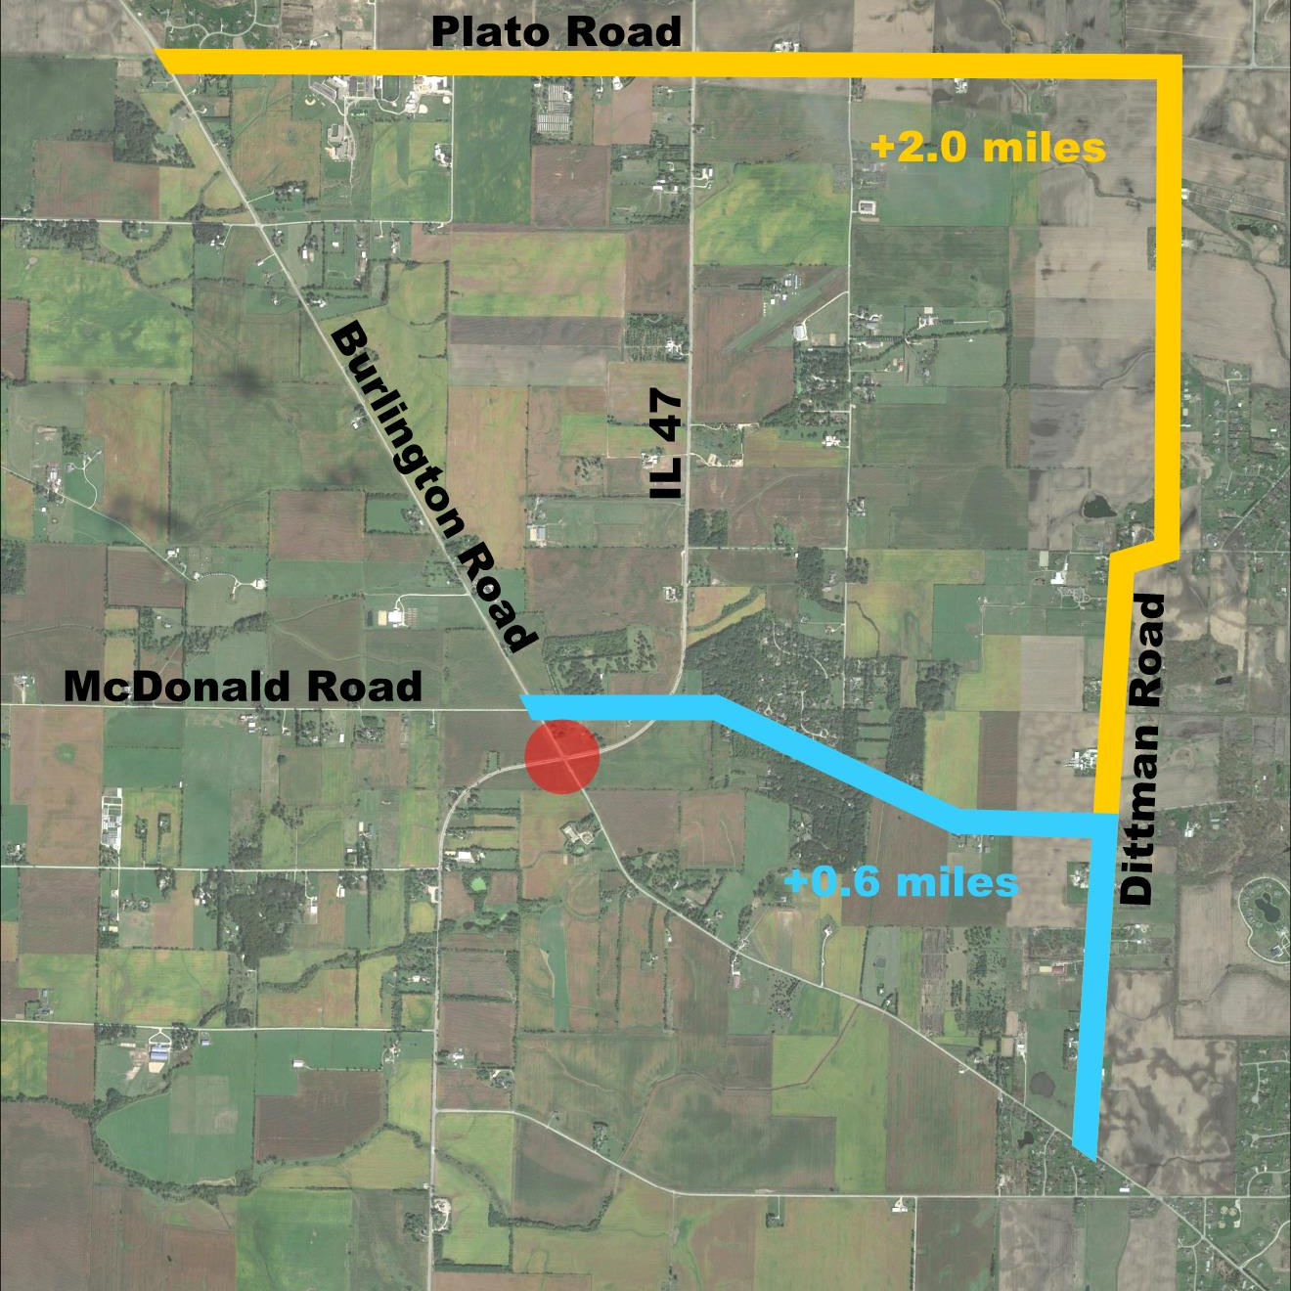
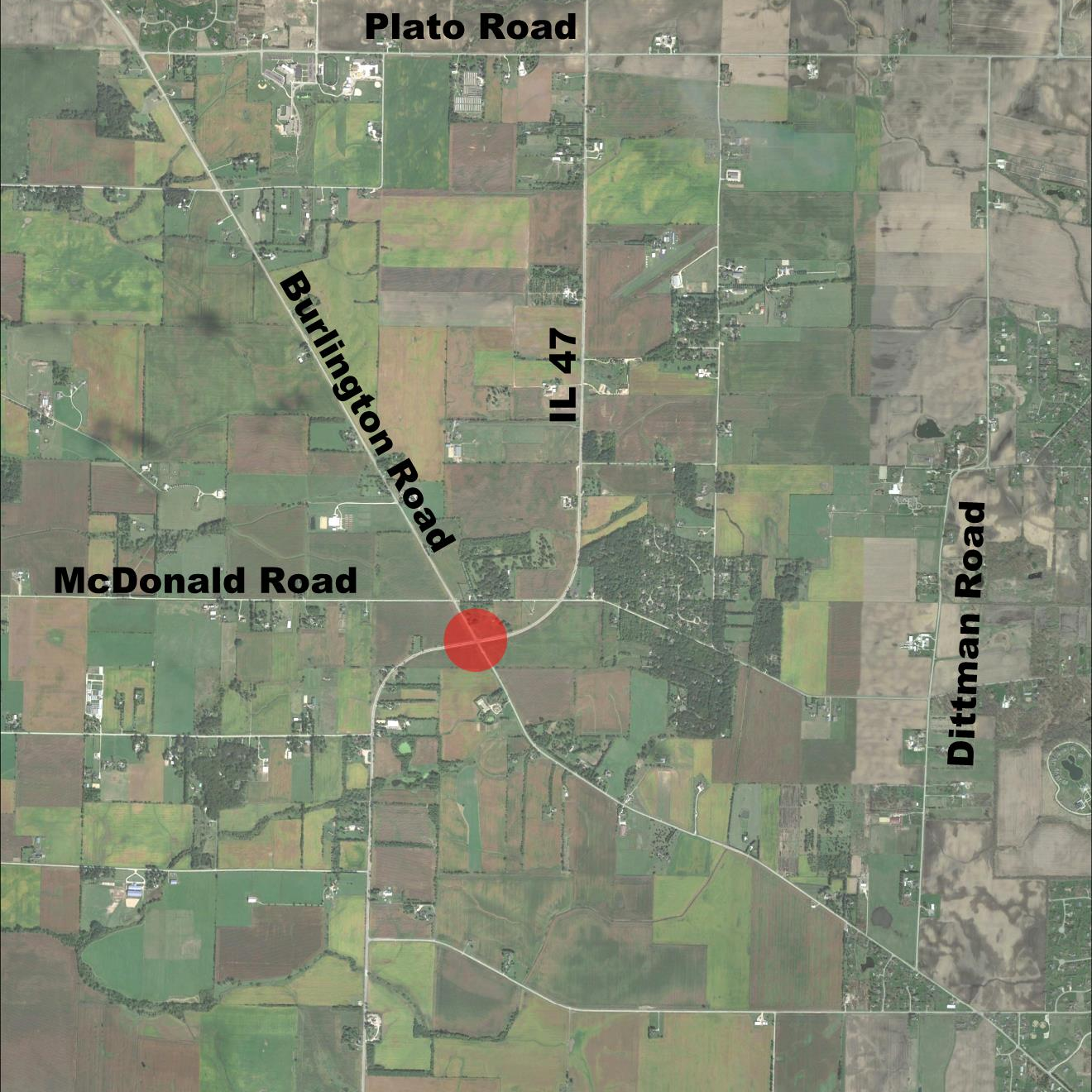
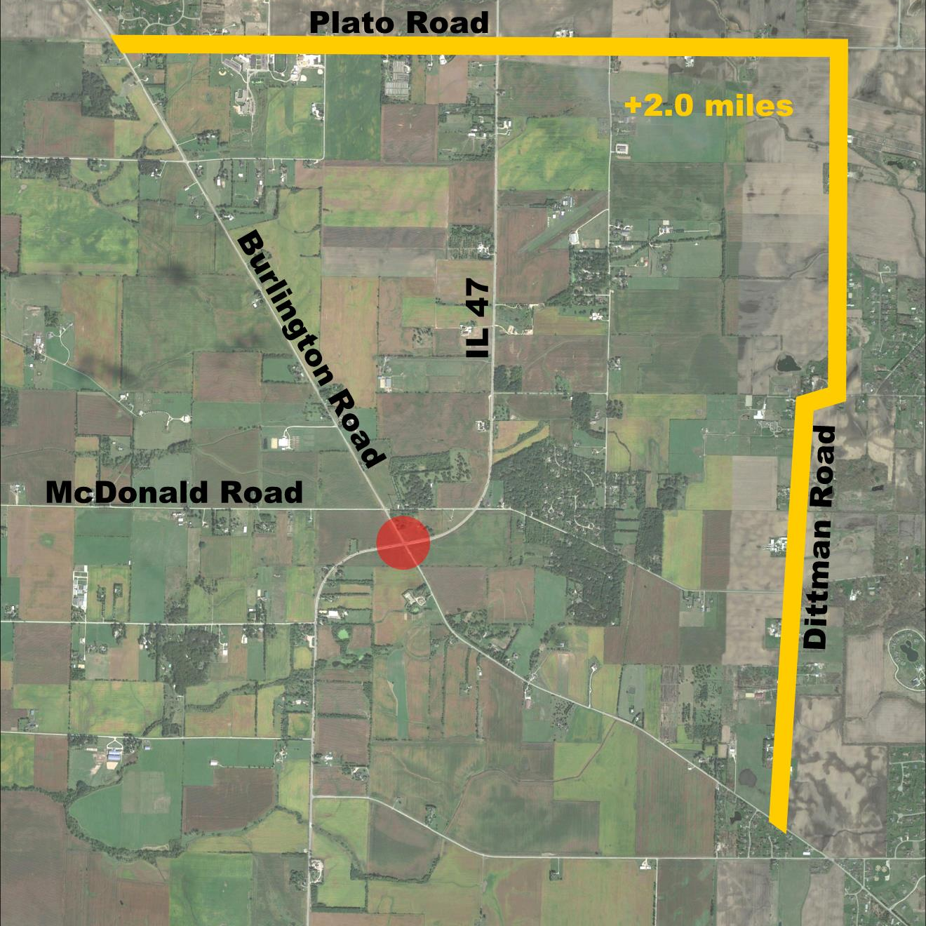
Contract Documents
Staging and Detours
Notes:
MAP7
Roundabouts can be very difficult to stage under traffic. We would have needed at least four construction stages, plus extensive temporary pavement, to build the roundabout while keeping both roadways open. As a result, we encouraged the use of a detour.
3.16+3.37-4.5 = 2.0 miles adverse travel
McDonald: 2.84 – 2.25 = 0.6 miles adverse travel
We should have done more to anticipate concerns at McDonald/47.

Slide 16
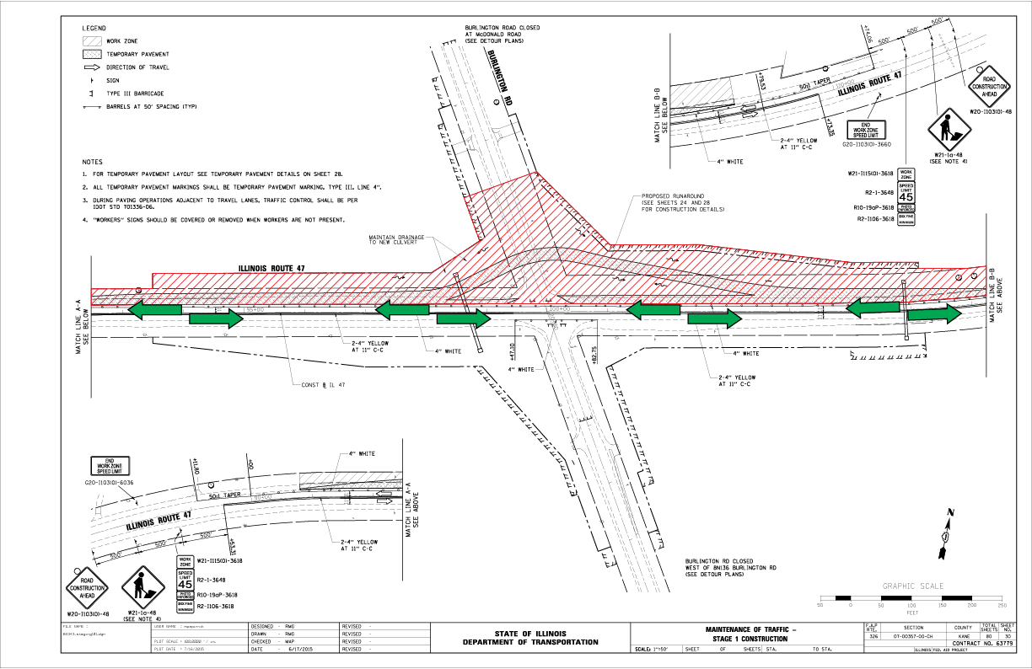
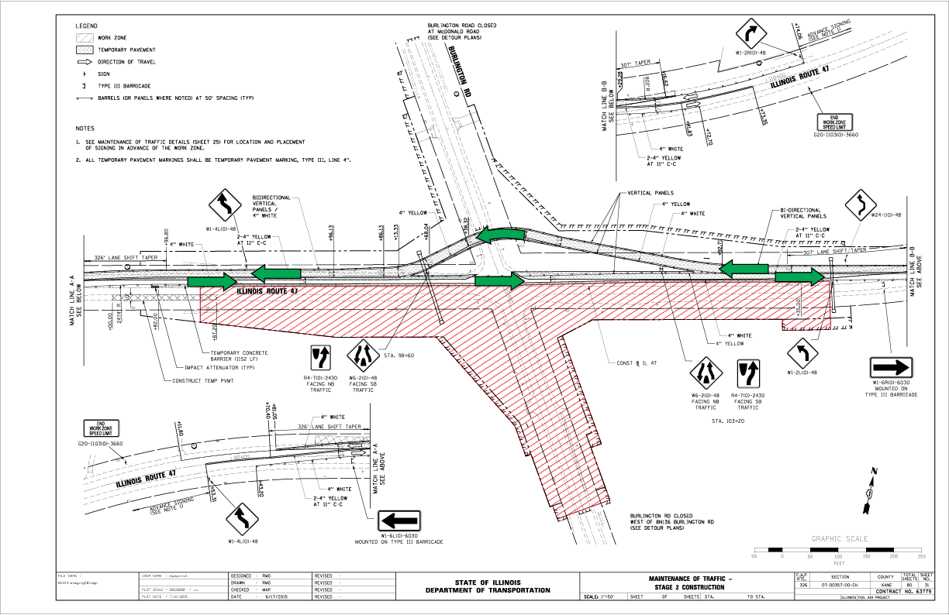
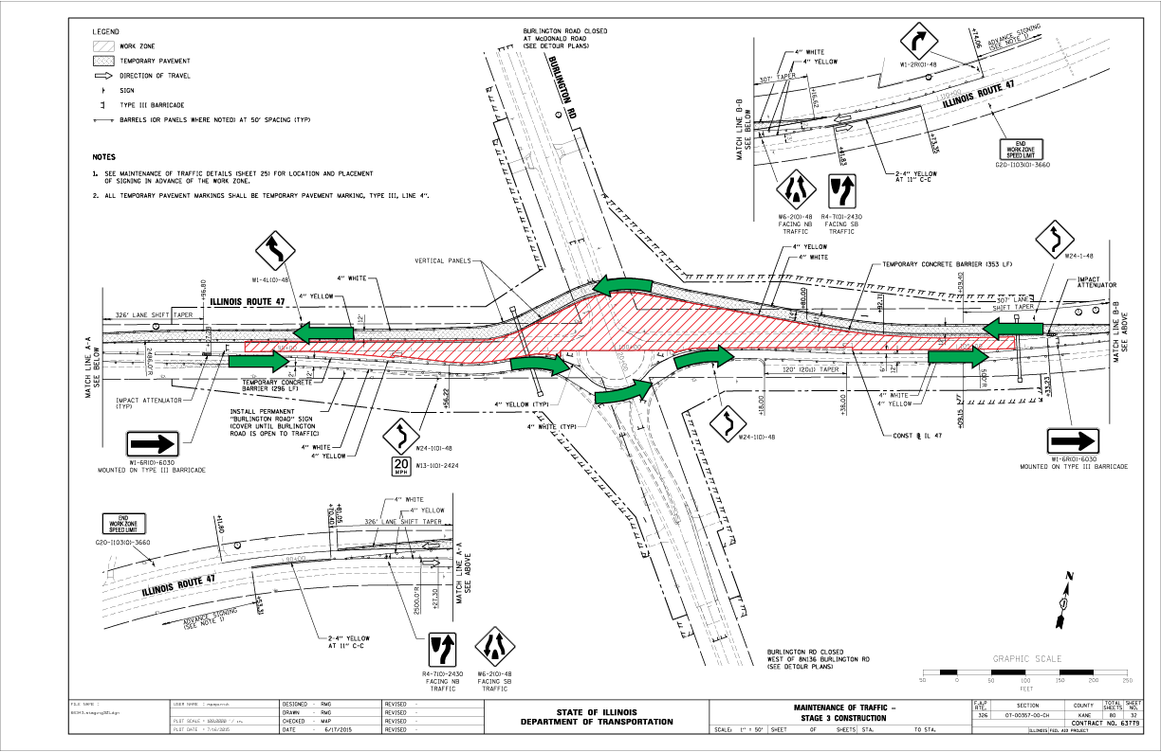
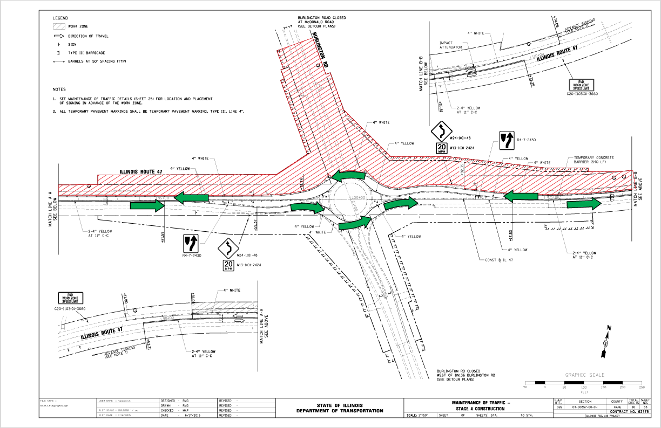
Contract Documents
Notes:
MAP7a
Three construction stages, including a prestage.
25mph runaround allowed by IDOT after early objection.

Slide 17
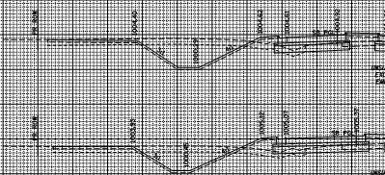
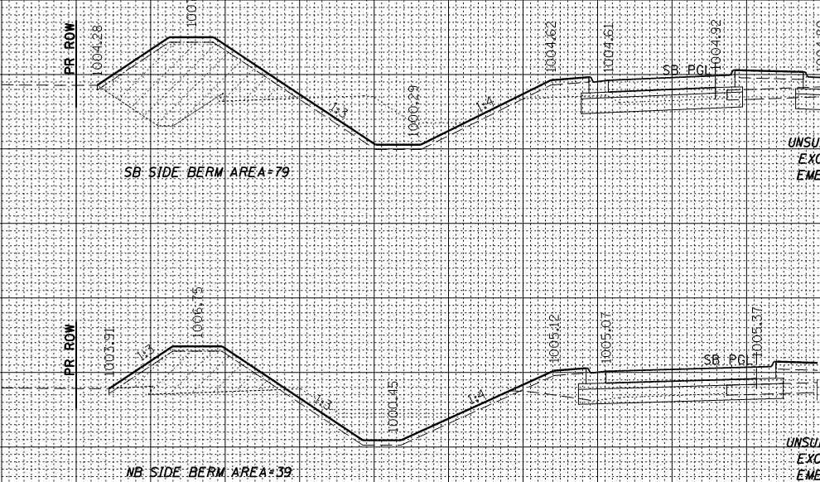
Contract Documents
Grading for Future Expansion
  “Sometimes it’s better to be lucky than good.”
Notes:
MAP7b
Roundabouts can be very difficult to stage under traffic. We would have needed at least four construction stages, plus extensive temporary pavement, to build the roundabout while keeping both roadways open. As a result, we encouraged the use of a detour.
Putting together the plans required even more attention to detail than we were used to. Again, with our experience being academic rather than practical, we needed to be as sure as we could be that the design could be built.

Slide 18
Land Acquisition
“Cooperate with the inevitable”
            words of wisdom from Dale Carnegie
Future Development Potential
  Owner concerns were anticipated regarding development and access
  Delays appeared unrelated to the roundabout in particular
Notes:
JEN 4:
The story of the land acquisition on this project is a familiar one.
It just took a very long time.
Longer than we wanted it to.
It took us 3 years to acquire the 4 parcels we needed from 2 property owners.
We anticipated that the land owners would have a major concern with
The future development potential of their farmland due to the roundabout.
Interestingly, this concern was totally unfounded.
The reluctance to sell had nothing to do with the roundabout design and was
Merely a matter of price.

Slide 19
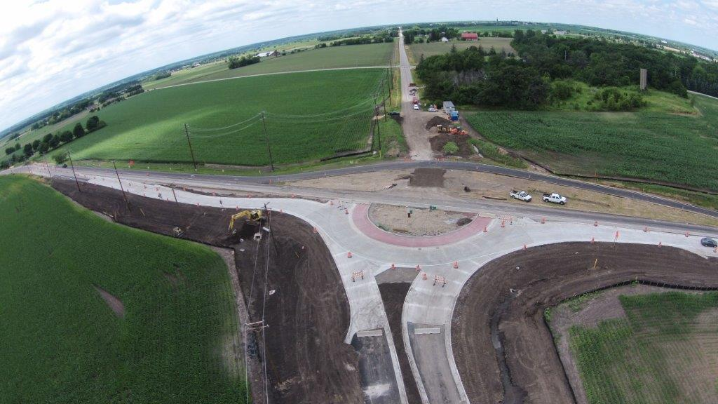
Construction
Staged construction = incremental learning
  Shortens the learning curve
  Gradually adds traffic
  Minimal competing traffic made bigger gaps
Notes:
JEN 5:
Matt mentioned the 4-stage construction sequence featuring a runaround
earlier but I want to touch on this again because it was important to KDOT
to allow our Roadway users to gain confidence and learn how to navigate
this new intersection incrementally.
We knew there would be a learning curve associated with this new intersection
type and the staged construction sequence gradually added traffic in to the
roundabout allowing regular users to acclimate themselves with minimal
competing traffic.
Basically giving them bigger gaps in the traffic as they learned out to use it.
From a contractor perspective this approach Minimized temporary pavement
Eliminated long term detours awkward crossovers and partial curb installations

Slide 20
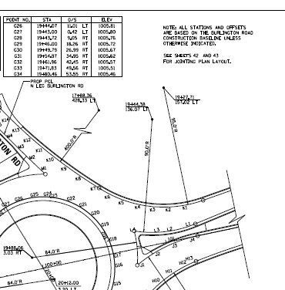
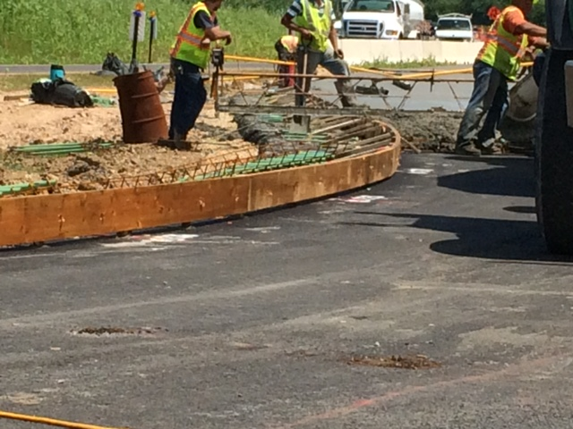
Construction
Education
Coordination and Participation
Notes:
JEN 5:
Several factors contributed to the ease and success of construction of this project.
STV, our resident engineer, did a really great job of being proactive and
educating themselves on the designers intent.
Martam, our contractor, built the Crescent Boulevard/Crescent Court roundabout in
Glen Ellyn, also designed by Burns & McDonnell, in 2015 and so seemed comfortable
with the unusual layout and forming effort required.
You can see here in the photo they were about to place the form within a finger’s
width of the stabilized subbase.
Of course they were able to do that because of the station / offset detail sheet Matt
Included in the plan set.
They had the information they needed for success.

Slide 21
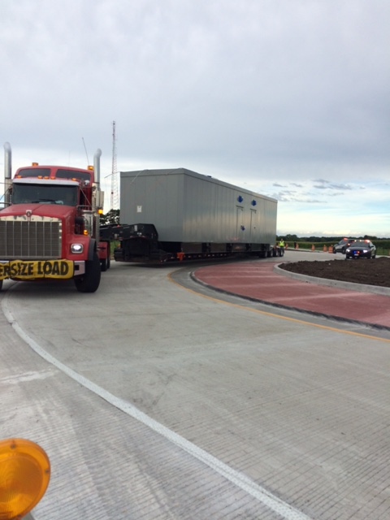
Construction Challenges
Wide Load Restrictions
Earthwork
Lighting
Notes:
JEN 6:
I know I said earlier that we are not going to do a “lessons learned” presentation
but I do think it would be helpful to touch on some of challenges we had to
overcome during construction.
As we construct our next roundabout we will accommodate wide loads through
every stage of construction. Despite our effort to restrict wide loads in our
work zone we did have a wide load attempt to navigate our partially opened
roundabout and he got stuck. We were able to get this guy out of there by
removing one of his hitches. It is important to note he would have fit the fully
opened roundabout.
Another moment of uncertainty we had earlier on in construction is when we
came across more undercut material than we expected. The ROW we acquired
barely accommodated our bermed grading and so we did go to a closed drainage
system and fill in some of our drainage ditches to keep our earthwork balance onsite.
And finally, despite a warning given in a presentation given by Lake County earlier
in the year, we did run in to the very same problem that they did with lighting
installation delaying the opening of the roundabout. Shop drawing review of the
lighting design and long lead times on ordering lighting equipment should all be
given ample time in your construction schedule.

Slide 22
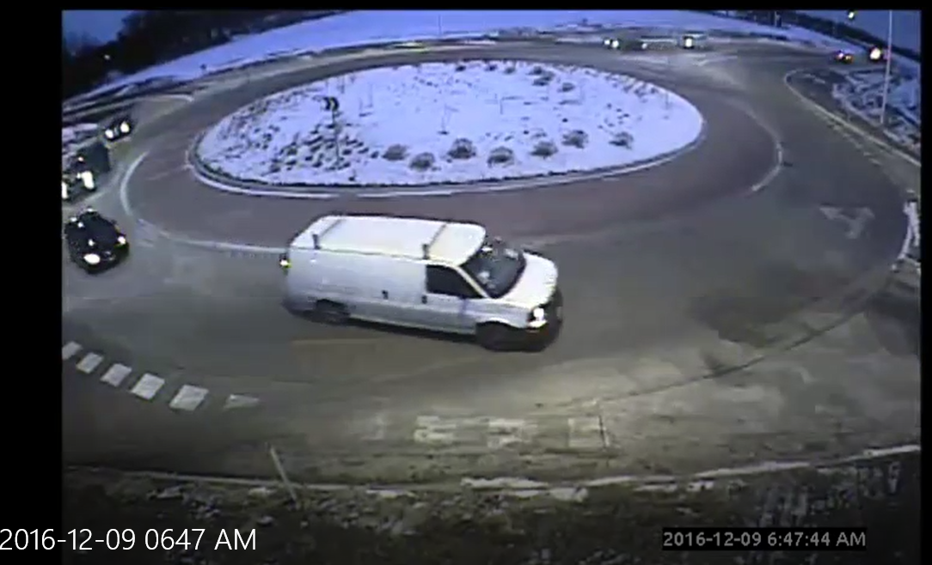
Operations - Public
Public Opinion and Response
  Initial misgivings by locals and
  elected officials
  Near silence since opening
                “Let me tell you about my first experience driving the roundabout.”
I didn’t even have to stop!
Notes:
JEN 7:
I made a lot of phone calls in preparation for this presentation today to obtain
feedback, good and bad, about the operation of the roundabout and I was surprised
at how little information I was able to get. Even when I called our most vocal detractors
from the design phase I had a hard time getting any specific feedback and sometimes
a hard time even establishing a conversation. I think the lesson here is that, sometimes,
as engineers, it is enough to know that we have done a good job if people just don’t
have anything to complain about.
During my conversations with the roadway users over the past year I have found one
commonality, they all want to tell me about their first experience driving through the
roundabout. It usually involves eyes wide open as they say in surprise,
“and I didn’t even have to stop!”

Slide 23

Operations - Police
Campton Hills Chief of Police
  Minimal number of incidents
  No injuries
  He expected worse
  Intersection to the north seems safer too
It’s good, I guess.
Notes:
JEN 7:
I was able to speak with the Campton Hills Chief of Police a couple of times over the
past year and there have been 2 accidents at the roundabout, no injuries. He said that
was a perfectly reasonable amount of incidents to expect at a new intersection. I pressed
him further on the overall experience he has had out there and he said that he has had
a couple of general complaints about not liking the new intersection type but he expected
to get a lot more. He went on to say, “It’s good, I guess”.
But to me the most interesting part of our conversation was when the Chief deduced that
the intersection just north and east of the roundabout is safer now too. Before the
roundabout opened the intersection of IL Route 47 & McDonald Road had the highest rate
of accidents in the community but since the roundabout has opened there hasn’t been a
single accident at 47 & McDonald Road. The Chief believed that was related to the roundabout
and perhaps its new geometry reducing speeds along IL route 47.

Slide 24
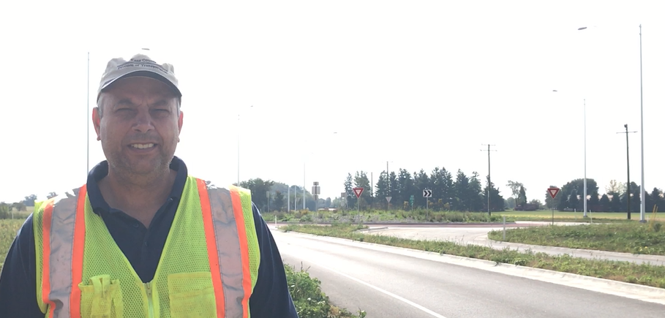
Operations - Maintenance
KDOT Maintenance
  Efficient at moving traffic
  Snow removal has worked well
It surprises me on how well it flows.
Notes:
JEN 8:
Bill Edwards is our Maintenance Superintendent at KDOT and has lived in this area for
over 40 years. He commutes through the roundabout to and from our facility daily.
He volunteered to go on the record to say that his initial reaction to the roundabout design
was negative. But since it has opened he has actually changed his mind about roundabouts
when they are done well.
He finds that it is efficient at moving traffic, snow removal has worked
well and that it has surprised him at just how well the traffic flows at the intersection now.
He believes that his commute to work is faster because of the roundabout.
Our maintenance staff really works as a liaison between our organization and the roadway users
and so these are important words coming from the man responsible when anything needs to be
repaired, cleaned, plowed or mowed.

Slide 25
Operations - Agricultural
I have no problem getting my combine through here.
Agricultural perspective
Notes:
JEN 9:
And finally I want to touch on the agricultural perspective with regard to operations, because
this roundabout is in the middle of a cornfield. The farmers were concerned. And we did all we
could to alleviate those concerns in advance of construction.
On this slide you will see the autoturn exhibit Matt created for one of our local farmers.
Matt built his CASE IH 8120 combine, along with the 30’ trailer he tows behind it,
in autoturn to show the farmer that his 17.5’ piece of equipment would fit in the circulating lane of traffic.
I called this farmer recently to find out how last year’s planting and harvest went. He said
he has no problem navigating the roundabout with his combine.

Slide 26
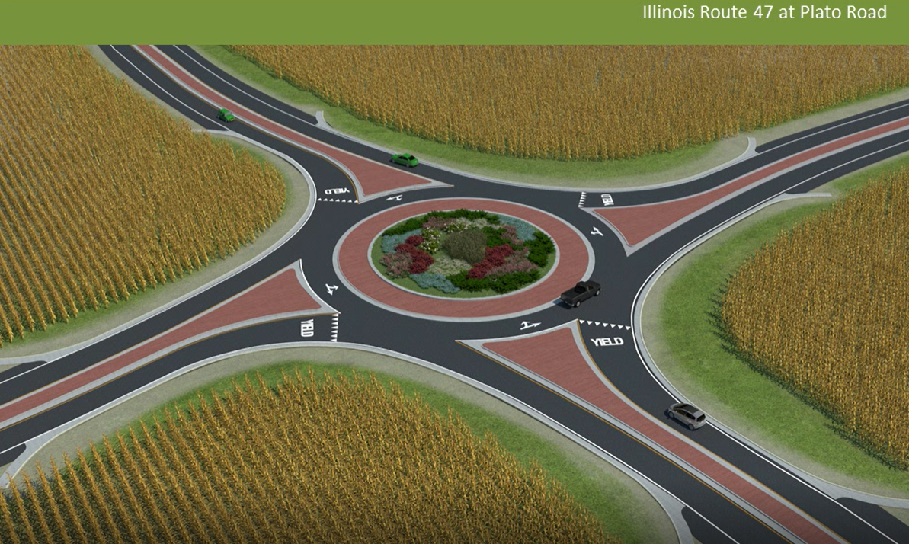
Future Roundabouts in Kane County
IDOT’s Plato Road & IL Route 47
Notes:
JEN 10:
Based on the strength of the Burlington 47 roundabout we have a line-up of
future roundabouts planned for Kane County in various stages of design.
And I want to take a moment to talk about just a few that might be of interest.
Later this year IDOT will let their roundabout at Plato Road & IL Route 47
just a few miles north of Matt’s roundabout and this project will be in
construction through 2019.
After a thorough analysis IDOT chose a roundabout over a traffic signal
for this intersection primarily for it’s superior safety performance as well
as it’s reduced ROW footprint.

Slide 27
Future Roundabouts in Kane County
KDOT’s Bunker Road & Keslinger Road
  Capacity for future growth
  Safety along this high speed corridor
  Cost
Metra Commuter Rail Station
Notes:
JEN 11:
Another roundabout KDOT has in the land acquisition phase is the Bunker Road
& Keslinger Road roundabout as part of the Bunker Road Extension project.
Like the Burlington & 47 roundabout this one is in a rural setting and so ROW
and construction staging are more attainable. It is currently a 2-way stop
controlled intersection and the north leg here experiences delays when a
train arrives from the LaFox Metra station just northeast of the intersection.
Stop control, a traffic signal and a roundabout were all considered during the
alternatives analysis phase and the roundabout was the clear winner when we
considered the following:
Capacity for future growth – since we have a couple of residential developments
planned in this area
Safety – because the 3 point deflection geometry of the modern roundabout will reduce speeds
as vehicles approach the intersection along this high-speed corridor
And, of course, Cost
This project is locally funded through the construction phase and so we
hope to break ground early next year.

Slide 28
Future Roundabouts in Kane County
KDOT’s Bliss/Main/Fabyan Intersection
  Improved intersection skew angle
  Reduction in superelevation through the intersection
Notes:
JEN 12:
Finally we have a very interesting project just south of the Bunker Road & Keslinger Road
project which realigns the offset intersections of Bliss Road & Main Street and
Main Street & Fabyan Parkway into one 4 legged oval shaped roundabout.
During the analysis of the different intersection treatments for this project the advantages
the roundabout provides here include not only your typical ones, like improved level of service,
but also improved intersection skew angle and a reduction in superelevation through
the intersection.
A public hearing was held during the Phase I Engineering Study and the design team and I
were surprised that a large majority of those attending the meeting, including ALL of the
key stakeholders, were in support of the roundabout treatment for the intersection.
This project is also in the land acquisition phase and KDOT is seeking federal funds to
help us build this one.

Slide 29

Owner’s Notes
Analysis
  Design
  Context
Do you have
  a place in mind
  for your first
  roundabout?
Notes:
JEN 13:
A thorough analysis has to be done at each location to determine the intersection
treatment that is most appropriate, as we did with Burlington 47, and these project
locations are ideal for roundabouts. Maybe at this point you are thinking of a
good location for one in your community?
Matt was more than just a PM for this project. He is an ambassador for the
modern roundabout and while he was literally up at night worrying about this
project, in the end, the roundabout belongs to the community in which it sits.
And it is up to the Owner to make it work within it’s community, to help
define its context. To understand how it operates and the sites unique traffic flows.
To understand which trucks are leaving which industry and when.
How your maintenance supervisor plans to repair it and plow it. How the local farmer
plans to harvest his crops around it. We even called the nearby high school to
make sure the driver’s ed teachers remember to take their students through it.
We had the right chemistry of traffic flow and balance and a great design and that
made this a great location for KDOT’s first roundabout.

Slide 30
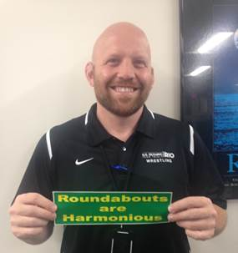
IDOT Perspective
Jason Salley, District 1 Geometrics Engineer
“Viable tool in the toolbox”.
Additional planning
Additional public involvement
Lighting:
  Required by IDOT on all roundabouts
  Cost participation is dependent on who leads the engineering
  If DOT-led, DOT pays for lighting.
  If locally-led, local entity will pay for construction of lighting
  Locals maintain lighting in either case
Notes:
“As far as the Department’s perspective, here goes – they are a viable tool in the toolbox, but one that takes a lot more planning and public involvement due to the relative uniqueness of them to the Chicagoland area. One thing of note is that the Department does require that if a roundabout is proposed that it is illuminated/lit. The cost participation on the lighting is dependent upon who leads the engineering of the project. If the Department leads the engineering on the project, the Department will pay for the construction of the lighting. However if the project is locally initiated, that local entity will pay for the construction of the roundabout. In both cases however, the local entity is required to own and maintain the lighting at the roundabout.”
To which I’d add that Jason’s

Slide 31
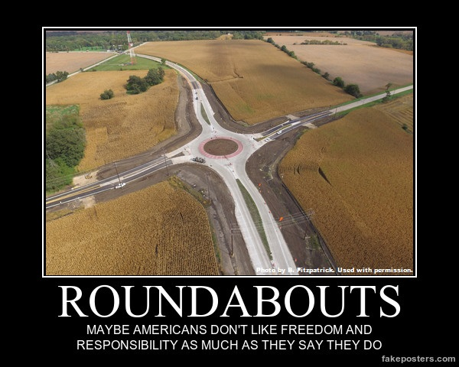

Slide 32
Questions?
Jennifer O’Connell
oconnelljennifer@co.kane.il.us
Matt Papirnik
mpapirnik@burnsmcd.com

